Slide 1

Phase 1, Module 3: Data Types & Data Integrity
Khyber AI Systems Engineer (KASE)
Welcome back. Today we look at the raw materials of our AI systems: Numbers and Text. But we are going to look at them like engineers, focusing on precision, memory, and formatting for production.
Presented By: Zaryab Ahmad

Slide 2
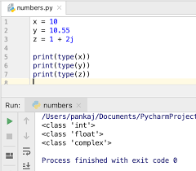
The Numerics (Integers vs. Floats)
The Danger of Decimals
Integers (int): Whole numbers. In Python, they can be infinitely large.
Floats (float): Decimal numbers. They are stored using the IEEE 754 standard.
The Trap: Computers cannot store fractions perfectly in binary. 0.1 + 0.2 does NOT equal 0.3.

Slide 3
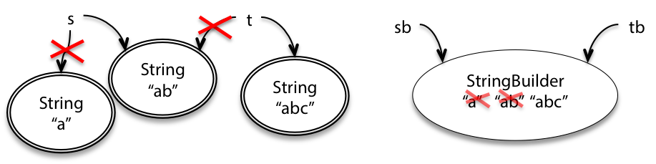
Strings as Immutable Sequences
Text is Carved in Stone
A String (str) is just a sequence of characters in memory.
Immutability: Once a string is created, you cannot change a single letter inside it.
To "change" a string, Python actually destroys the old one and creates a completely new one in RAM.

Slide 4
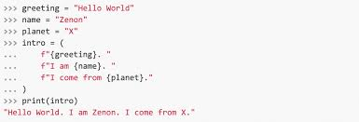
Modern String Formatting
The 2026 Standard (F-Strings)
Old Way (Pre-2015): %s or .format() (Slow and hard to read).
Modern Way: F-Strings f"Hello {name}".
Why? F-Strings are compiled directly in C, making them mathematically faster and much cleaner for API development.

